Slide 1




CHANGING THE GAME IN
ADOLESCENT-CENTERED DESIGN:
ASSETS, ACCESS, ADHERENCE
#changingthegame #AIDS2108
Please tag @grassrootsoccer

Slide 2
YouthPower
Youth-driven approaches for SRH and HIV education, prevention, and treatment
Elizabeth Berard
USAID/Office of HIV/AIDS

Slide 3

Overview
USAID- We’re all about Positive Youth Development (PYD)
Youth in the drivers seat (2 examples)
YouthPower resources

Slide 4
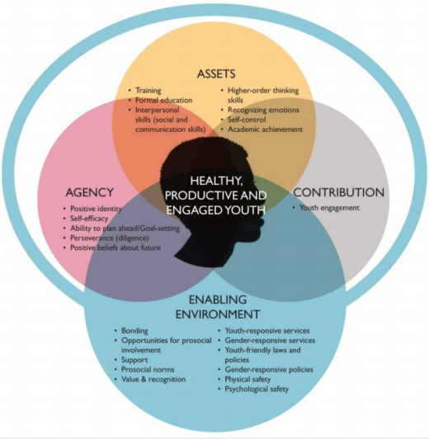
We’re all about Positive Youth Development (PYD)
ASSETS + AGENCY + ENABLING ENVIRONMENT + CONTRIBUTION = Healthy, Productive, and Engaged Youth

Slide 5
PYD works! Look at those SRH & HIV/AIDS outcomes
Statistically Significant Outcomes
Boys/girls report higher self-efficacy to use condoms with their partners
Reduced sexual risk behaviors (ie- fewer sexual partners, more youth using condoms consistently, fewer youth having unprotected sex)
Self-efficacy to use contraceptives
Adolescent girls report fewer incidents of unwilling sex
Reduction in teenage pregnancy
Reduction of HIV related stigma
More youth using SRH services
Systematic Review of Positive Youth Development Programs in Low and Middle Income Countries, 2017, YouthPower Learning

Slide 6



Slide 7

1. YouthPower Action:
Supporting AGYW as Leaders -South Africa
50 AGYW in DREAMS districts of Gauteng
Receive training on advocacy and leadership
Using new skills, plan and implement focused activity as a group building upon DREAMS goals in their community
Participate in provincial /national coordinating structures/governing councils focusing on AGYW issues
Capture learning with recommendations for other countries to replicate/adapt approaches

Slide 8




2. YouthPower Learning:
YouthLead
Connecting Youth Changemakers Around the Globe
Coming Sept. 2018

Slide 9
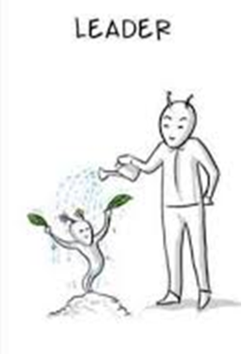
YouthLead will include:
Opportunities to connect youth to each other to share learnings and offer peer-to-peer assistance.
Easy access to information about funding opportunities.
Ability to post innovations.
Links to resources relevant to young leaders and other networks, (e.g., Global Shapers, YouthPower Communities of Practice, Ashoka, etc.).
Easy access to experts for guidance and advice.
A content repository to store and share their tools, resources, events and other content.
Leveraging of social media for access by site members – where possible.

Slide 10
3. YouthPower Action:
Anyaka Makwiri (Smart Girl) Pilot
GULU, UGANDA
22 Anyaka Makwiri groups formed
490 Adolescent Girls Young Women (AGYW) participated
88 mentors trained to facilitate sessions
6 months implementation

Slide 11
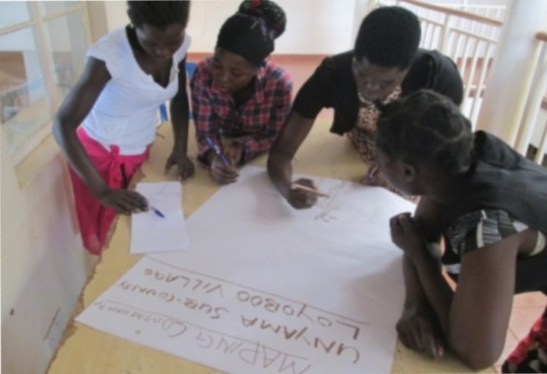
Workshops with AGYW
Girl-centered design workshops:
  Most prominent issues faced by AGYW,
  Topics they were interested
  in learning about,
  Safety in the community,
  Recommendations for
  mentor characteristics.
“There is violence in every home”

Slide 12
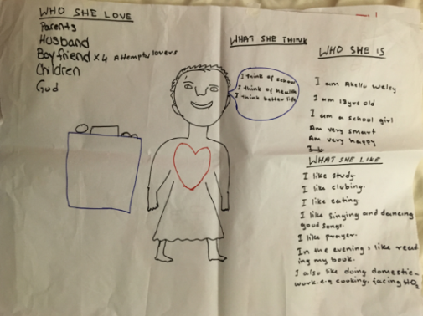
Workshops with AGYW
Challenges
Persistent gender-inequality
Domestic-violence
Sexual violence
Early marriage
Early pregnancy
Lack of work
School-drop out
Desired information
Relationships
Gender-based violence
Sexual and reproductive health
Communication
Financial capabilities

Slide 13
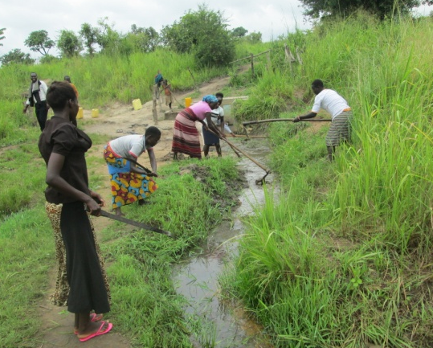
Youth Led Community Projects
Participants identified and implemented community service projects
Examples include:
  Water source clean-up
  Supporting the elderly by cleaning
  Cleaning Pit latrine of a school
  Compound maintenance-Church in Awach
  Erected hand cleaning tap (Tippy Taps)
  Fetching water for a health facility
  HIV prevention skit targeting CSW

Slide 14
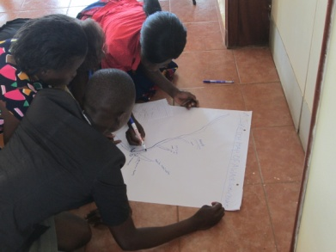
Program Results

Slide 15




Additional Ways to Engage with YouthPower
www.youthpower.org
Sign up for the YouthPower Newsletter
Sign Up for a Community of Practice
  Youth Engagement, Gender and Positive
  Youth Development, Youth in Peace and Security and Cross-Sectoral Skills for Youth.
Send useful resources to info@youthpower.org to share on the website.
www.youthpower.org
YouthPower Learning
@YP Learning
15

Slide 16
Thank you!
Elizabeth Berard
eberard@usaid.gov
The contents in this presentation are those of the presenter and do not necessarily reflect the view of the U.S. President's Emergency Plan for AIDS Relief, the U.S. Agency for International Development or the U.S. Government.
There is no conflict of interest to declare.

Slide 17
CHANGING THE GAME IN
ADOLESCENT-CENTERED DESIGN:
ASSETS, ACCESS, ADHERENCE
#changingthegame #AIDS2108
Please tag @grassrootsoccer

